Slide 1



















PROFESSIONAL PRACTICE (IT)
PROFESSIONALISM
LECTURE # 03

Slide 2

PROFESSIONALISM

Slide 3

PROFESSIONALISM TAKES MORE THAN KNOWLEDGE
“Professionalism is a way of thinking and living rather than an
accumulation of learning.”
Think:
What does it take to be a doctor?
Hint: it’s not just by going to medical school

Slide 4



Professional
A person who is expert at his/her work.
VALUES
The social principles, goals, or standards held or accepted by an individual, a class, a society, culture, etc. OR
The conduct, aims, or qualities that characterize or mark a profession or a professional person

Slide 5

PROFESSIONALISM
Conduct:
A specific style of behavior in the workplace.
“Professionalism refers to your conduct at work”.

Slide 6
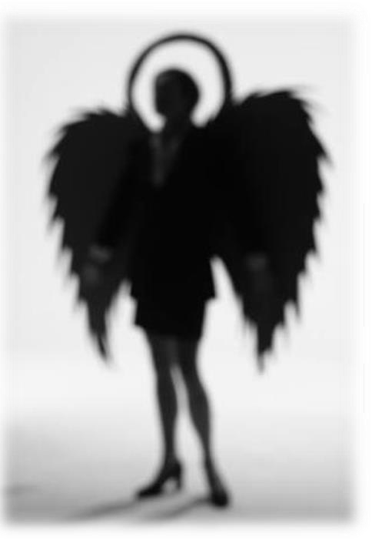
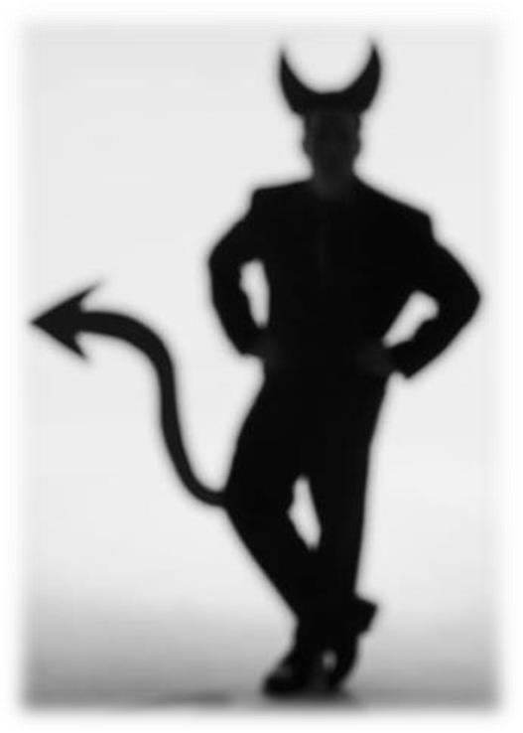
MORALS
Relating to, dealing with, or capable of making the distinction between right or wrong conduct.
principles
standards
beliefs with respect to right or wrong behavior

Slide 7
Right or Wrong
RIGHT
In accordance with fact, reason, justice, law, and morality.
Wrong
Contrary to fact or reason, unlawful, twisted, immoral, improper.

Slide 8






Mature responsibility and show passion for your work
Know how and achieve expected result
Give appropriate feedback and on time to the co-workers and supervisor
Respect for self and for others and
their time
Coming to work with a good attitude and performance
Professionalism in the workplace demands the following:
Be friendly and a team player
Problem solving perseverance Show a willingness to learn and
volunteer for new tasks

Slide 9
Important Keys to Being a True Professional in the workplace:
A good role model for others including, their behaviour, attitude and relationships
Good Timekeepers - always in before time, uses time well Dresses appropriately for the role
Speaks in a way which is appropriate to each different audience without being patronizing or putting people down.
Knowledgeable about the job, organization, etc.
Good with people

Slide 10


Important Keys to Being a True Professional in the workplace:
Communicate effectively, whatever the circumstances actively listens
Works well under pressure
Meets deadlines
Offer positive contributions in the official meetings
Prioritizes effectively - Is prepared to put in the time and efforts to get things done, but also manages to have a reasonable work life balance
Is accountable and takes responsibility for what they do and say, and for what they leave undone.

Slide 11
Professional interaction
Respect for colleagues is essential for workplace professionalism. Everyone has different ways of communicating and approaching issues – be tolerant of those differences and try to understand other perspectives.
Communication is key. It’s okay to speak up and ask for clarification when you don’t understand something. Issues are simply the result of miscommunication and having one simple discussion can resolve the situation
Individuals who listen and are open to the ideas and suggestions of their colleagues/supervisors demonstrate respectful behavior.
Keep personal information personal. When you’re at work, you should limit personal phone calls, emails, texting and other communications. Give co-workers your undivided attention.
Small actions, such as saying "please" and "thank you", help build collaborative workplace relationships and establish you as a professional who works well with others.

Slide 12
Professional interaction cont...
Email etiquette. So much business is conducted over e-mail, so it’s important to use this form of communication wisely.
Poor grammar and spelling can come across as unprofessional and give the impression that you’re not taking your role seriously.
You should also avoid adding emotional feelings (smiley faces, twinkle) and
acronyms in your official e-mail massage.
If you are trying to emphasize a point, try italicizing your word. Similarly, always use proper punctuation and capitalization.
Do not start messages with “hey” or other casual phrases—always begin with “Dear…” Workplace e-mail is not Face book, Twitter or text messaging—it is a professional form of communication and should be taken seriously.
Finally, if you are addressing your supervisor or a co-worker and especially your clients, address them formally in your e-mails.

Slide 13
Professional interaction
cont...
Nine Ground Rules for Organized Team Behavior
No complaining at all until willing to take action.
Blame the process, not the person.
Respect everyone on the team, assuming good motives.
Directly confront, with no triangulation.
Voice opinions strongly and respectfully.
Only rely on and restate what you know to be absolutely true.
Fully commit to team decisions and strategies.
Create accountability among the team.
Be an advocate for the team and these ground rules throughout the organization.

